Slide 1
Raspberry Pi Camera
And image editing in Python

Slide 2
Before starting your Pi
Set up your Pi as normal
Don’t plug the power in yet
Install the camera
Find the long camera port, next to the ethernet port
open the camera port by lifting the latch on both sides
Insert the camera ribbon cable, with the silver contacts facing away from the ethernet port
Now push the latch down on both sides, if correctly inserted, you should be able to lift the Pi by the ribbon cable without it detaching

Slide 3
On Startup
Log in with usual credentials
Username: ‘pi’ Password: ‘raspberry’
The SD card has been newly imaged, so we need to do a few setup steps:
Type ‘sudo raspi-config’ and press enter
select ‘expand filesystem’, and confirm
camera should be enabled, but this is where you’ll find that option yourself
enable boot to desktop (2nd option)
Select finish, and accept the restart
Log in again, (‘exec startx’ if you did not enable boot to desktop)

Slide 4
Hello, World
A brief Python catch-up

Slide 5
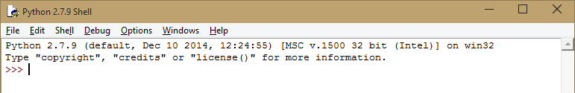
Hello, World
A brief Python catch-up
Open IDLE 2 (The blue/yellow icon in quick launch bar)
This will open up the Python interpreter

Slide 6
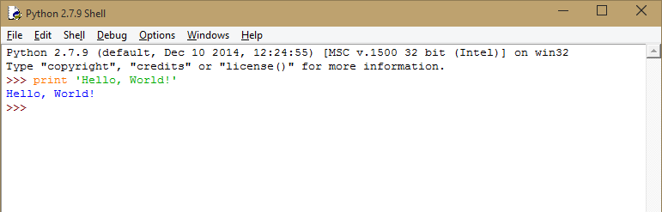
Hello, World
A brief Python catch-up
enter the following, then press Enter: print ‘Hello, World!’

Slide 7
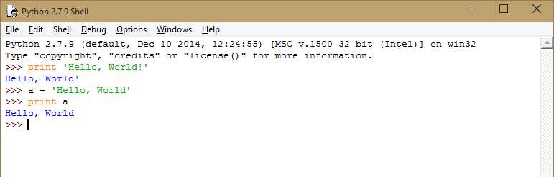
Hello, World
A brief Python catch-up
now try: a = ‘Hello, World’ print a

Slide 8
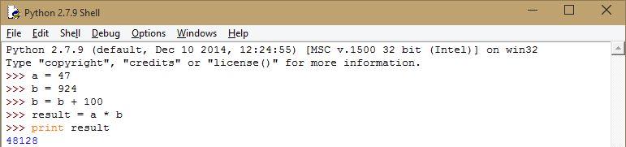
Hello, World
A brief Python catch-up
a = 47 b = 924 b = b + 100 result = a * b
print result

Slide 9
Take a photo
Using the picamera library

Slide 10
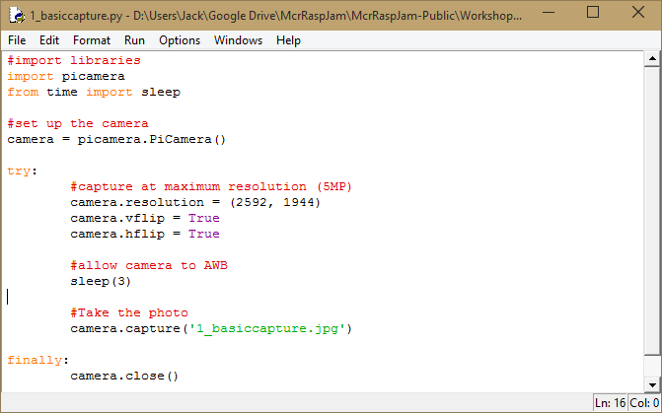
Take a photo
Using the picamera library
From IDLE, click File > Open
open camera-scripts/my-scripts/1_basiccapture.py

Slide 11
Take a photo
Examining the code
Libraries are bits of code written by other people.
The ‘picamera’ library will deal with all the complicated hardware interfacing for us
out of the entire ‘time’ library, we only need the ‘sleep’ function, so we’ll only import that one thing.

Slide 12
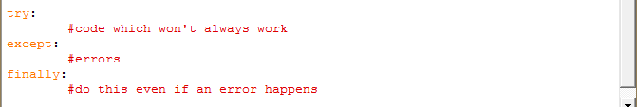
Take a photo
Examining the code
This is a little difficult to explain, you can just think of ‘camera’ as the camera itself
(In reality, ‘camera’ becomes an instance of the picamera API’s code, done for OOC reasons)
The try except notation allows errors to occur without stopping the program. Don’t worry about me!
(i.e. we want to stop the camera if the program crashes)

Slide 13
Take a photo
Examining the code
Set up the camera mode
‘camera’ is an object, as it has properties
to access a property, we use camera.property

Slide 14
Take a photo
Examining the code
wait for 3 seconds, then take a photo
The camera needs to perform auto white balancing before taking a photo

Slide 15
Take a photo
Examining the code
Try running the code. Then go to the folder in the file browser to find the photo
Run > Run Module (F5)

Slide 16
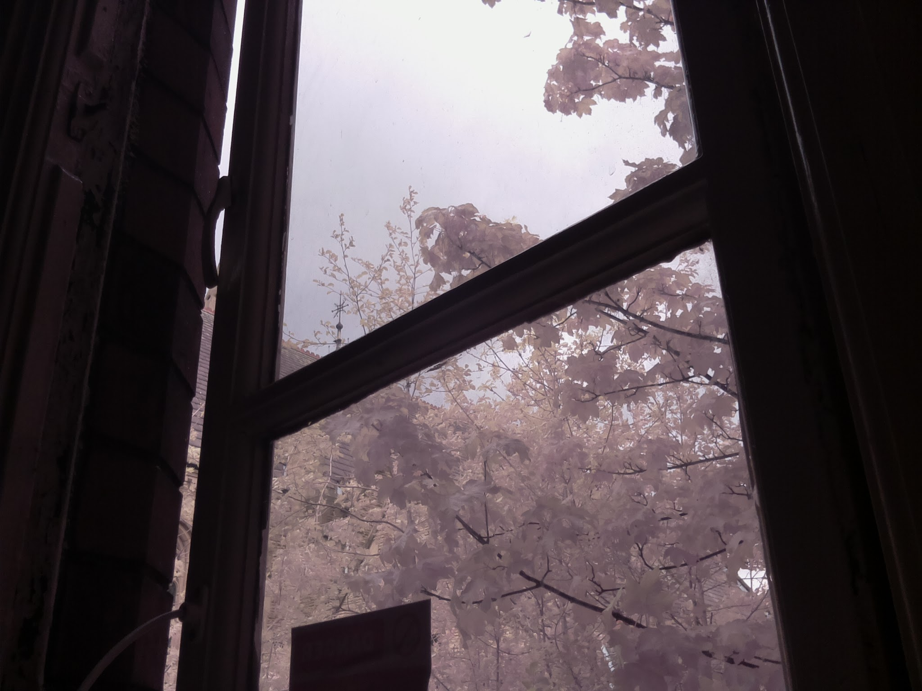

Slide 17
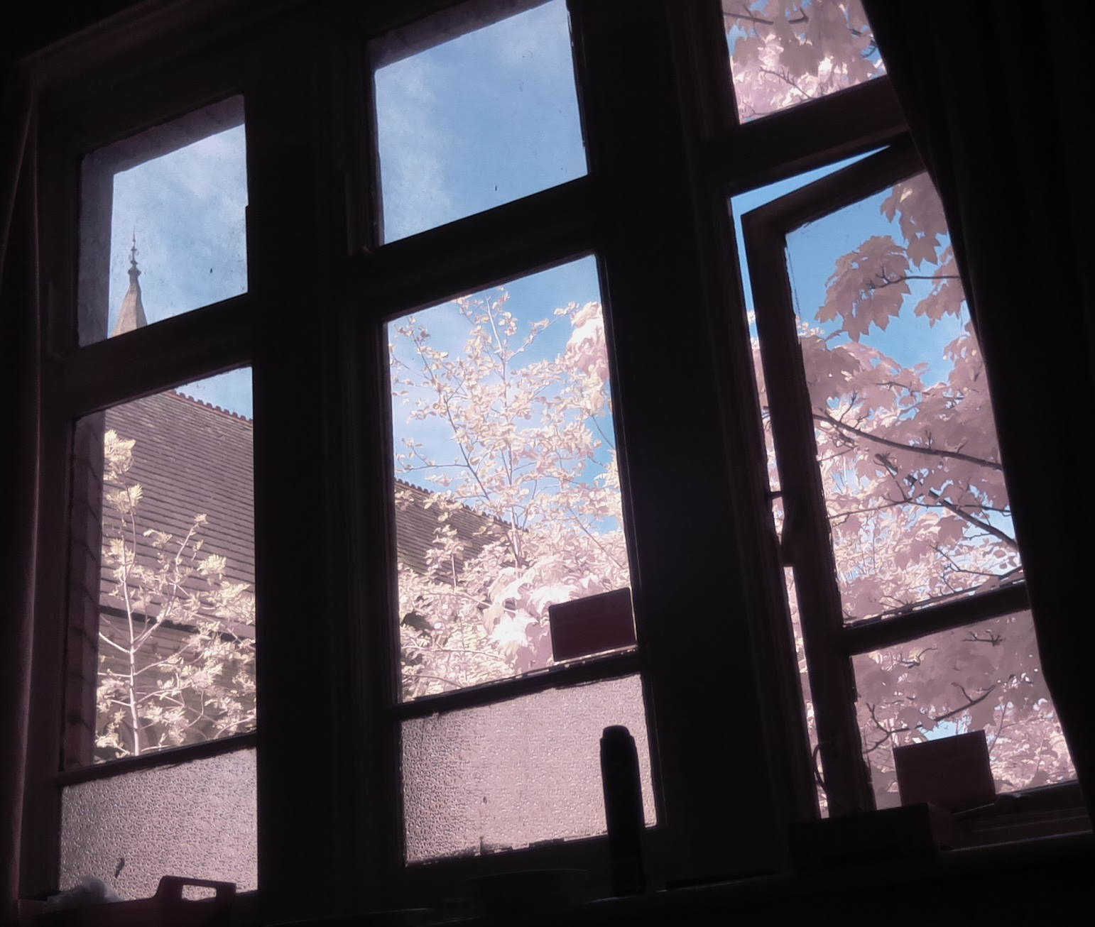
(Tangential)

Slide 18
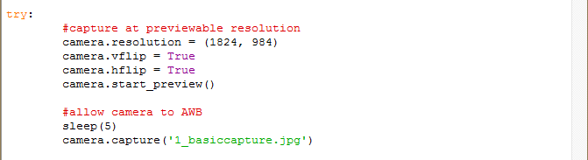
Take a photo
Improving the code
Add the following line where shown below: camera.start_preview()
Consider using a higher number for sleep(), to give you a longer preview

Slide 19
Manual exposure
setting extra camera properties

Slide 20
Manual exposure
Exposure time and shutter speed?
Each photograph has an exposure time, the time between the camera ‘opening’, and then ‘closing’ after shooting.
The camera only reads light during its exposure time. A longer exposure time gives a brighter image.
In the Pi camera API, we give the exposure time in microseconds.

Slide 21
Manual exposure
What is ISO?
ISO originates from the days of film photography, and was a measure of “film speed”.
A high ISO film would be more exposed than a low ISO film for the same exposure time.
Changing the ISO amplifies what the sensor receives, but amplifies noise too.

Slide 22
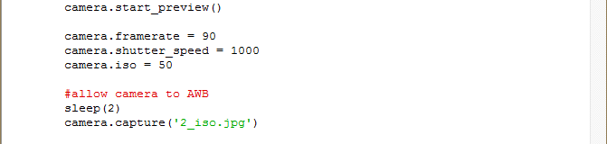
Manual exposure
setting extra camera properties
Add the following lines: camera.iso = 400 camera.shutter_speed = 2000 to get 1/250s in microseconds: 1/250 * 1,000,000 = 8000
(in python): time = (1.0/250.0) * 1000000.0

Slide 23
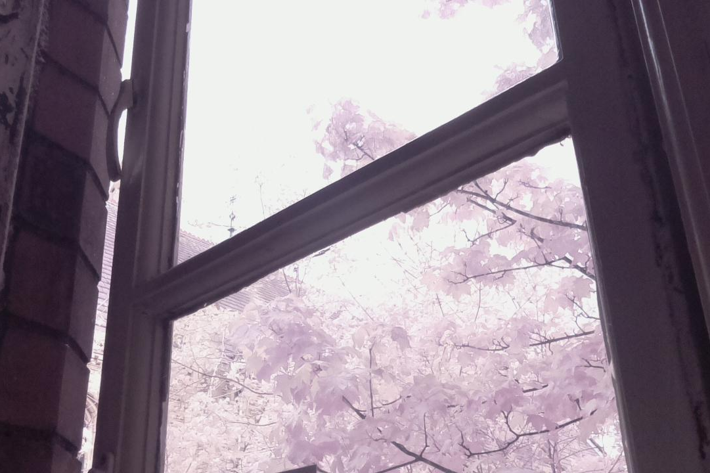

Slide 24
Basic image editing
changing brightness/contrast

Slide 25
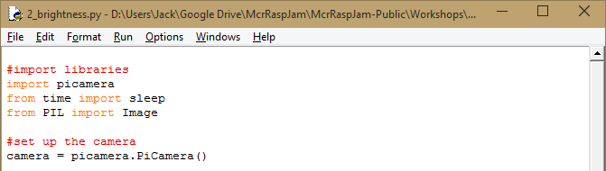
Basic image editing
changing brightness/contrast
Make a copy of your program, open the new copy in IDLE
Add the following line at the top of the file: from PIL import Image

Slide 26
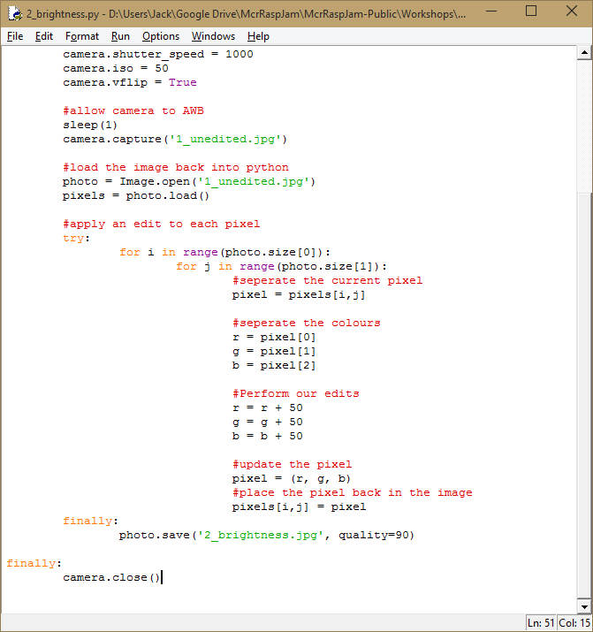
Basic image editing
changing brightness/contrast
Add the following lines after the camera.capture: photo = Image.open(‘1_unedited.jpg’) pixels = photo.load()
‘pixels’ is just the grid of pixels, ‘photos’ contains other image properties as well (e.g. format, size, etc)

Slide 27
Basic image editing
changing brightness/contrast
Add the following lines after the camera.capture: photo = Image.open(‘1_unedited.jpg’) pixels = photo.load()
‘pixels’ is just the grid of pixels, ‘photos’ contains other image properties as well (e.g. format, size, etc)

Slide 28
Basic image editing
changing brightness/contrast
Inside the try: for i in range(photo.size[0]): for j in range(photo.size[1]):

Slide 29
Basic image editing
changing brightness/contrast
pixel = pixels[i,j]
r = pixel[0]
g = pixel[1]
b = pixel[2]

Slide 30
Basic image editing
changing brightness/contrast
r = r + 50
g = g + 50
b = b + 50
pixel = (r,g,b)
pixels[i,j] = pixel

Slide 31
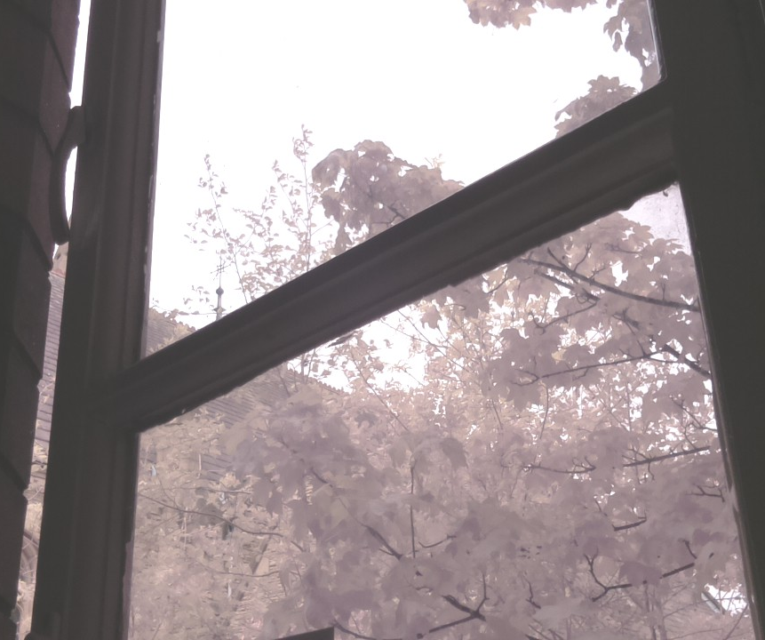

Slide 32
Basic image editing
changing brightness/contrast
For contrast change:
r = r + 50
g = r + 50
b = r + 50
to:
r = int(r*1.5)
g = int(g*1.5)
b = int(b*1.5)
to avoid confusion, we use * instead of x for multiplication

Slide 33
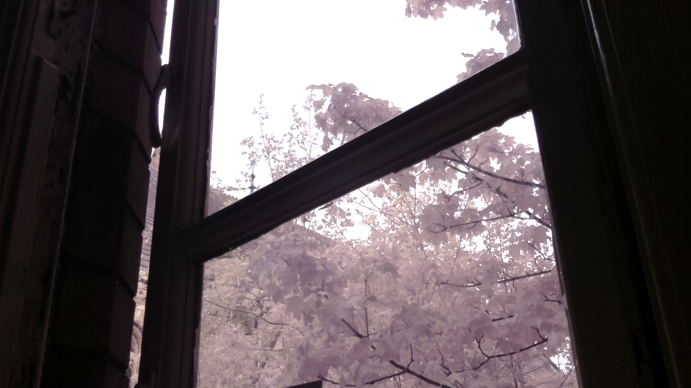
Make a copy of your script as it currently is! we’ll come back to it later

Slide 34
Less basic image editing
Blurring an image

Slide 35
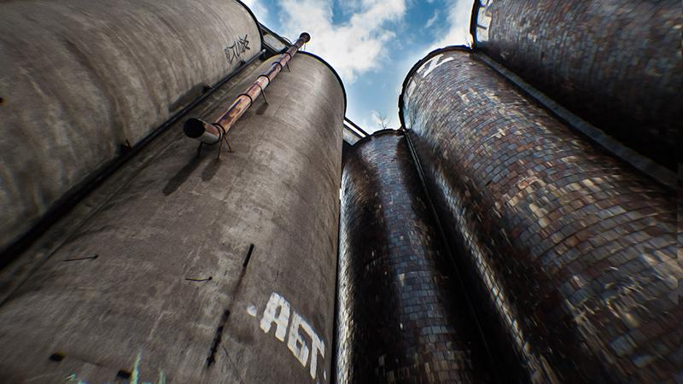

Less basic image editing
Blurring an image

Slide 36
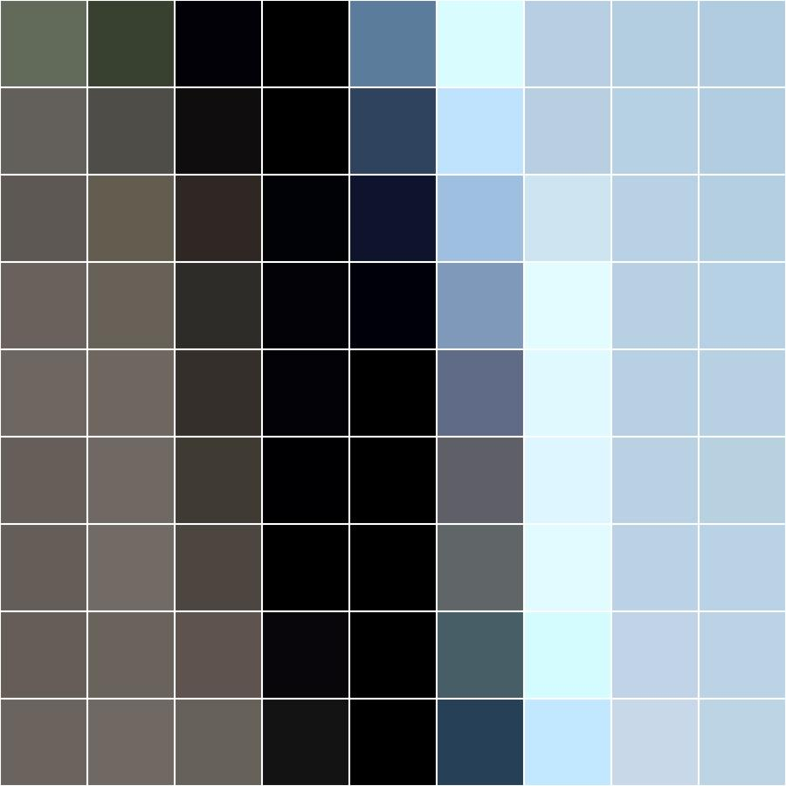
Less basic image editing
Blurring an image

Slide 37
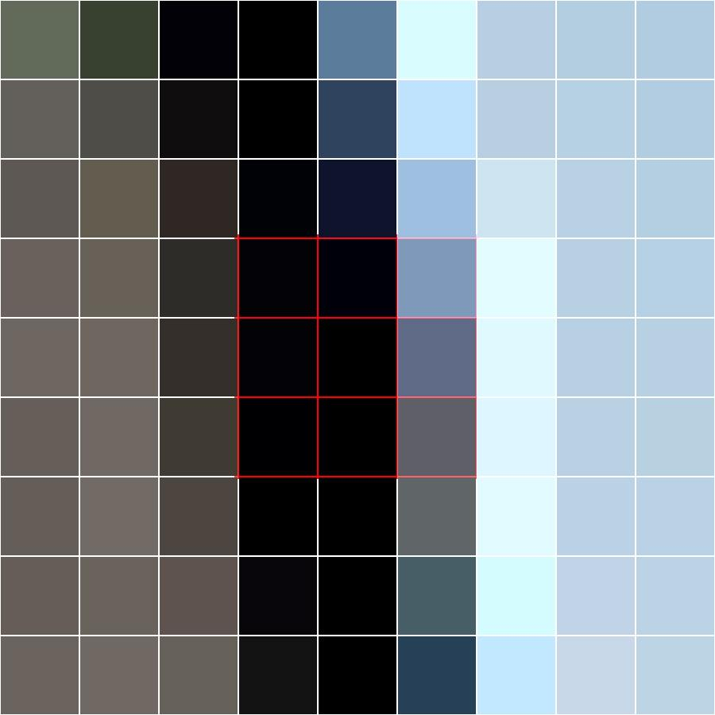
Less basic image editing
Blurring an image

Slide 38
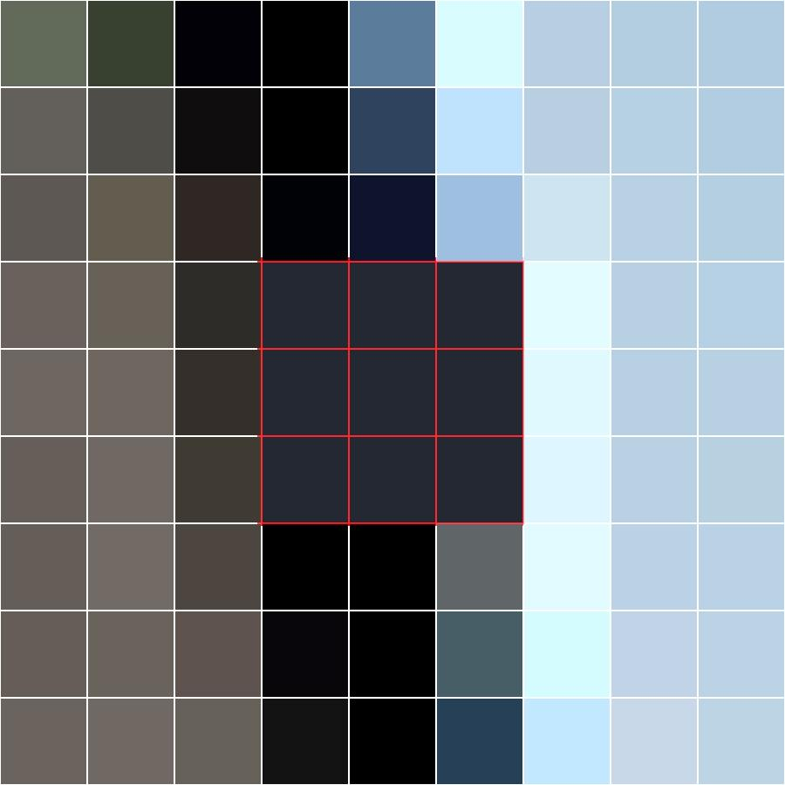
Less basic image editing
Blurring an image

Slide 39
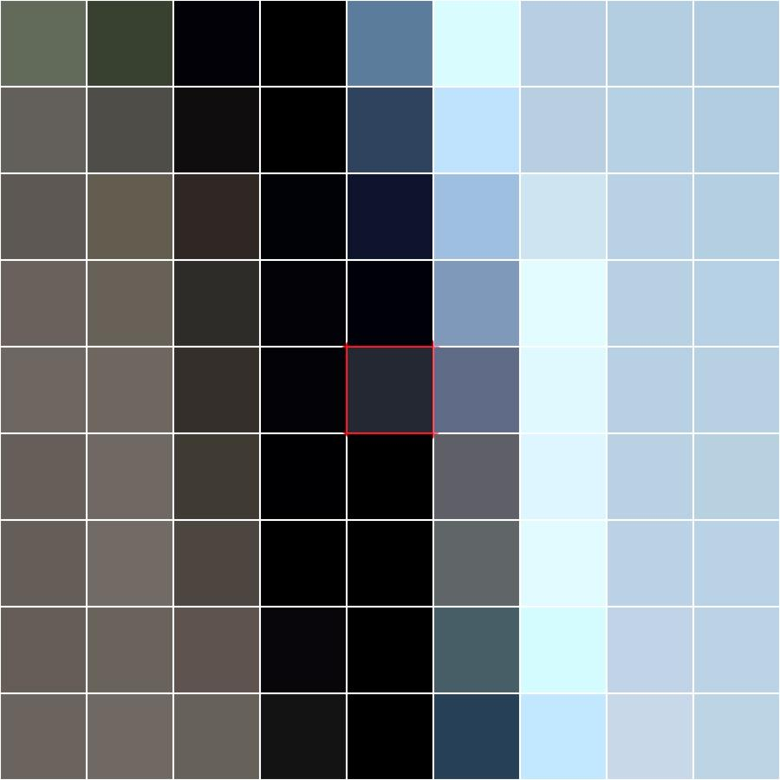
Less basic image editing
Blurring an image

Slide 40
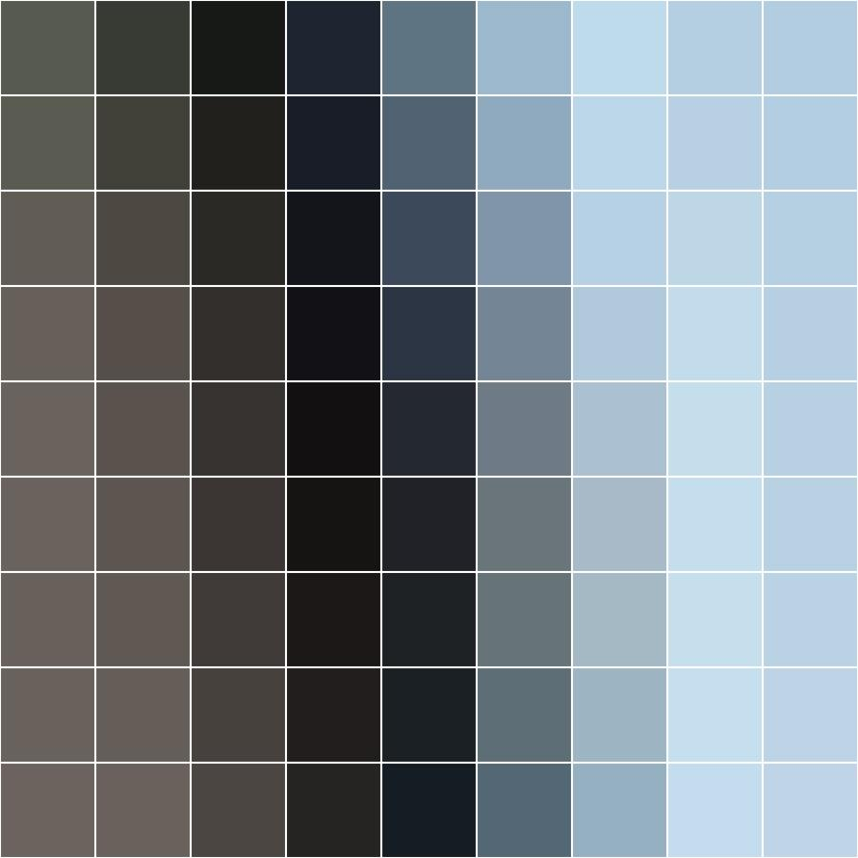
Less basic image editing
Blurring an image

Slide 41
Less basic image editing
Blurring an image
Think about the amount of computing we need to do for this!
as well as editing each pixel, we need to compare 9 pixels to get each pixel! (more if we want to increase the blur, the next level requires 25!)
for a 1080p image (2MP)we need to compute with: 18,662,400 pixels for a 1 pixel blur (317m lines of python!) 51,840,000 pixels for a 2 pixel blur (881m lines of python!)

Slide 42
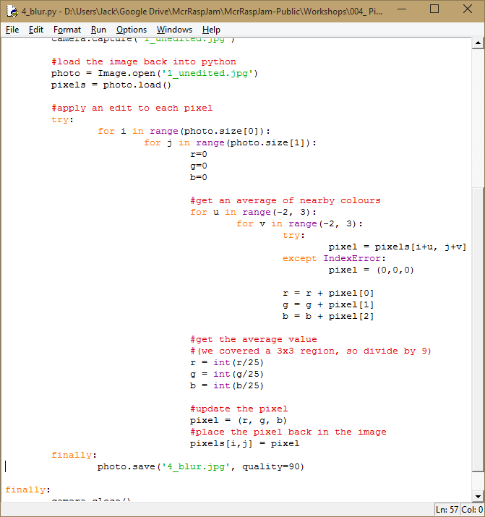
Less basic image editing
Blurring an image

Slide 43

Less basic image editing
Blurring an image
We’ll be adding all the pixel values together to average them, so we’ll start counting from 0:
r = 0
g = 0
b = 0

Slide 44
Less basic image editing
Blurring an image
Add all the pixel values for the average:
for u in range(-2, 3):
for v in range(-2, 3):
try:
pixel = pixels(i+u, j+v)
except IndexError:
pixel = (0,0,0)

Slide 45
Less basic image editing
Blurring an image
Add all the pixel values for the average:
for u in range(-1, 2):
for v in range(-1, 2):
try:
pixel = pixels[i+u, j+v]
except IndexError:
pixel = (0,0,0)
r = r + pixel[0] g = g + pixel[1] b = b + pixel[2]

Slide 46
Less basic image editing
Blurring an image
now get the average, and we’re done:
r = int(r/9.0)
g = int(g/9.0)
b = int(b/9.0)

Slide 47
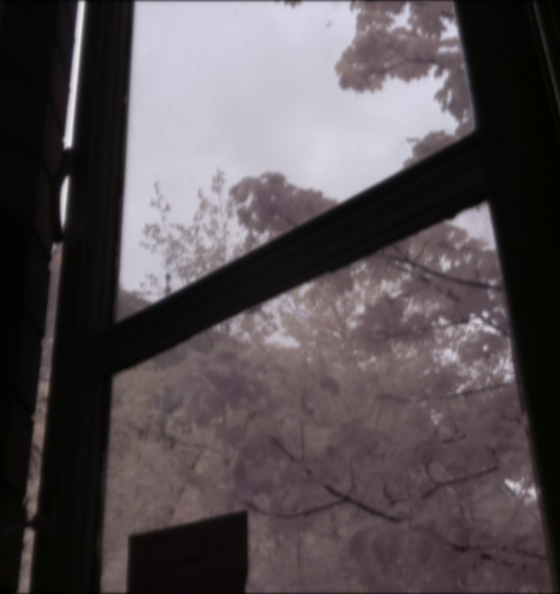

Slide 48
Gradient filters
Don’t make photos good

Slide 49
Gradient filters
Don’t make photos good
Open a copy of the contrast script you made before.

Slide 50
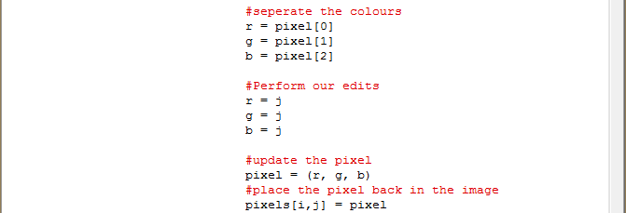
Gradient filters
Don’t make photos good
In the lines increasing the RGB values, change them to:
r = j
g = j
b = j

Slide 51


Slide 52


Slide 53
Gradient filters
Don’t make photos good
To make the gradient cover more of the image:
r = int(j/2.0)
g = int(j/2.0)
b = int(j/2.0)

Slide 54
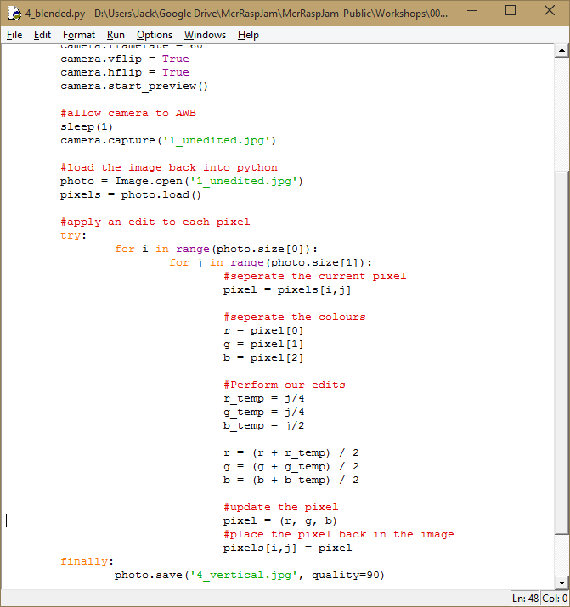
Gradient filters
Don’t make photos good
To make the gradient blue:
r = int(j/4.0)
g = int(j/4.0)
b = int(j/2.0)

Slide 55
Gradient filters
Don’t make photos good
now blend the gradient:
r = (r+r_temp) / 2
g = (g+g_temp) / 2
b = (b+b_temp) / 2

Slide 56
Gradient filters
Don’t make photos good
now blend the gradient:
r = (r+r_temp) / 2
g = (g+g_temp) / 2
b = (b+b_temp) / 2

Slide 57
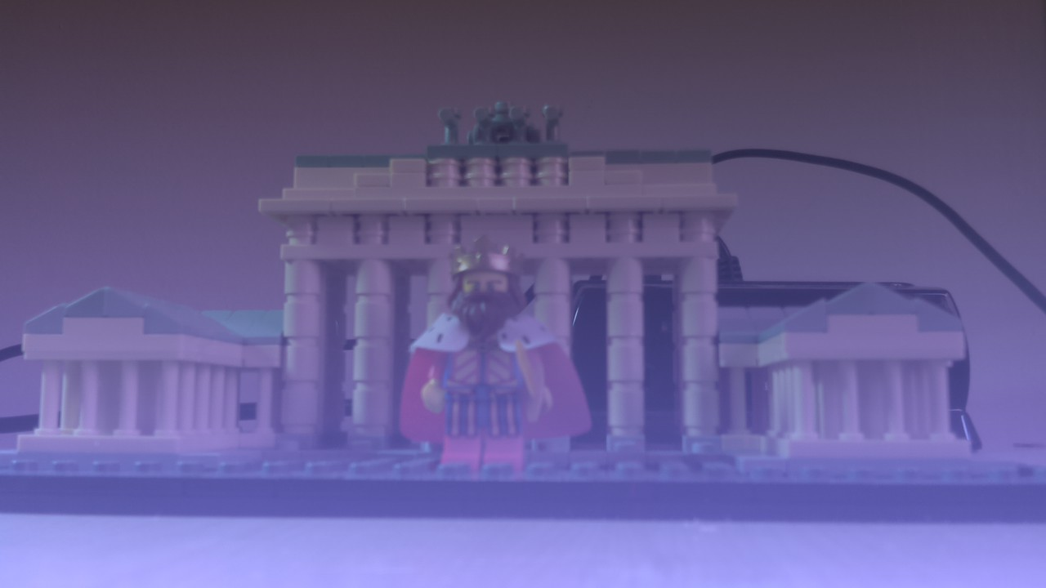

Slide 58
Gradient filters
Don’t make photos good
to fix the low contrast:
#Perform our edits
r_temp = (j/4) / 200.0
g_temp = (j/4) / 200.0
b_temp = (j/2) / 200.0
r_temp = int(r_temp * r)
g_temp = int(g_temp * g)
b_temp = int(b_temp * b)
r = r_temp + (r*2) / 3
g = g_temp + (g*2) / 3
b = b_temp + (b*2) / 3

Slide 59
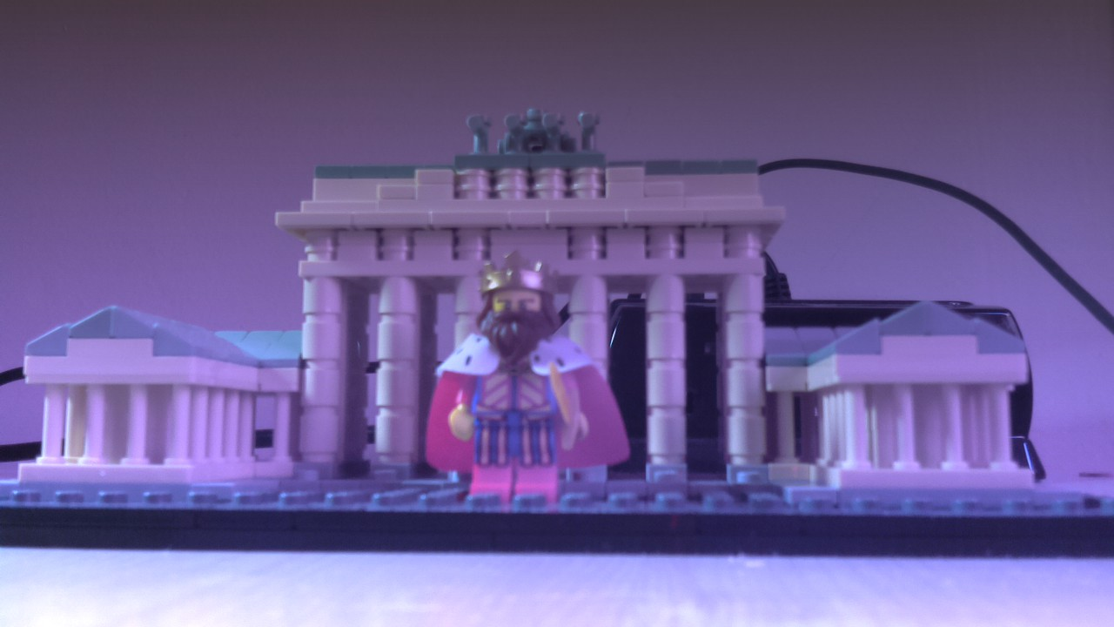

Slide 60
Gradient filters
Don’t make photos good
For multicoloured filters, we can use multiple directions for the rgb values :
r = int(j/2.0)
g = int(j/2.0)
b = int(j/2.0)
r = int(i/2.0)
g = 100
b = int(j/2.0)

Slide 61
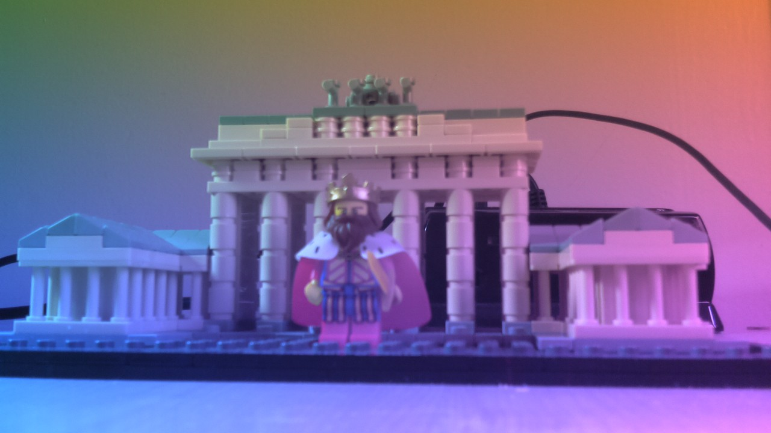

Slide 62
Experiment!
Try make something new and interesting
Have go at changing some of the gradient-creating values.
Make sure the resulting values stay within the 0-255 range. you can use:
if r > 255: if g < 0:
r = 255 g = 0
Prizes for interesting results?

